Slide 1
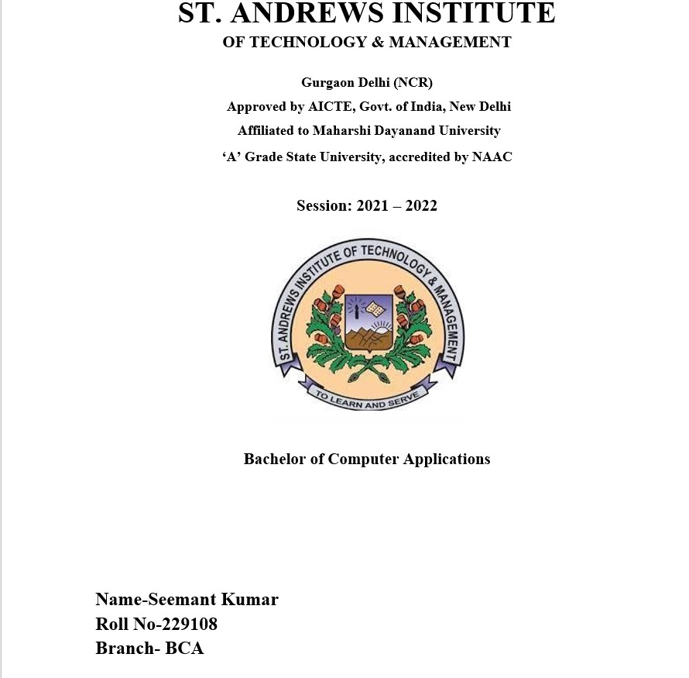
Name-Sumit pal
Roll No-229089
Branch-BCA

Slide 2
ACKNOWLEDGEMENT
I Would Like to express my special thanks of gratitude to my technical trainer “Garvit Verma” sir as well as our DEAN sir who gave me a golden opportunity to do this project of web development.
Secondly, I would also like to thanks my friends who helped me a lot in finalizing this project within the limit time frame.
Lastly, I like to thank my suppoters who have motivated me to fulfil their project before the timelimit.
Date-1-12-2022
Sumit pal

Slide 3
CERTIFICATE
This is to certify that “Sumit Pal” student of branch BCA has successfully completed their web development project on “A-JIO” under the guidance of “Garvit Verma”.
Student’s Signature
Teacher’s Signature

Slide 4
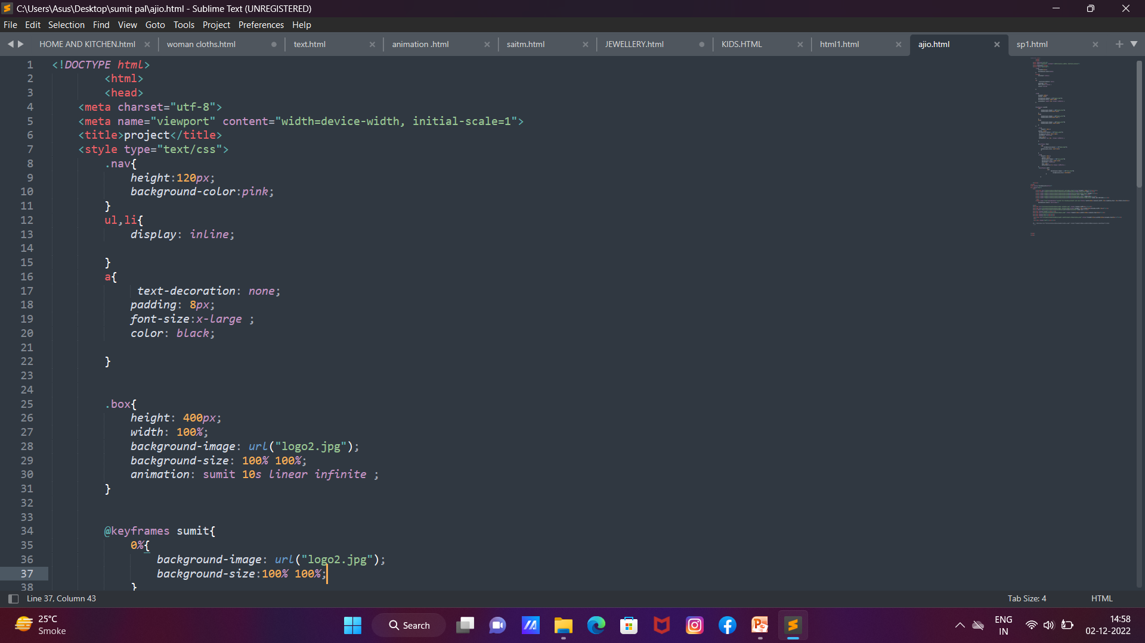
Source Code(HTML)

Slide 5
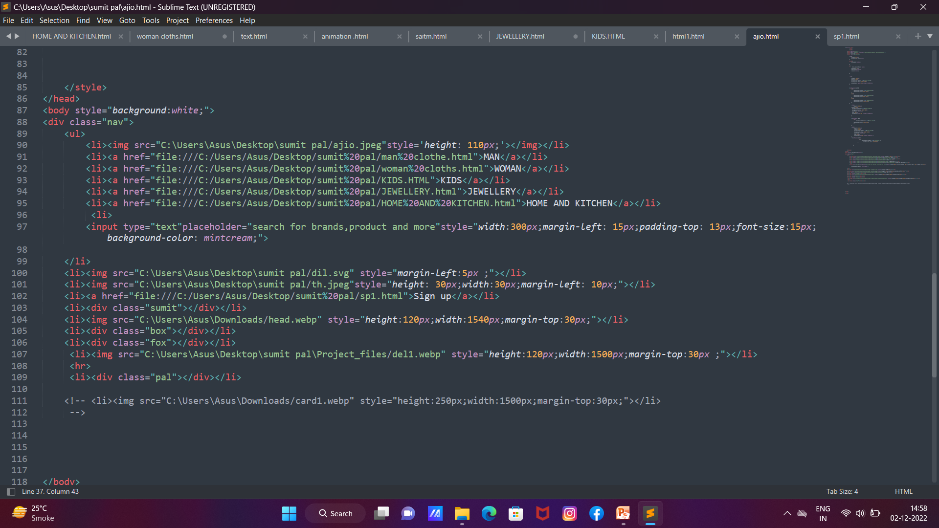

Slide 6
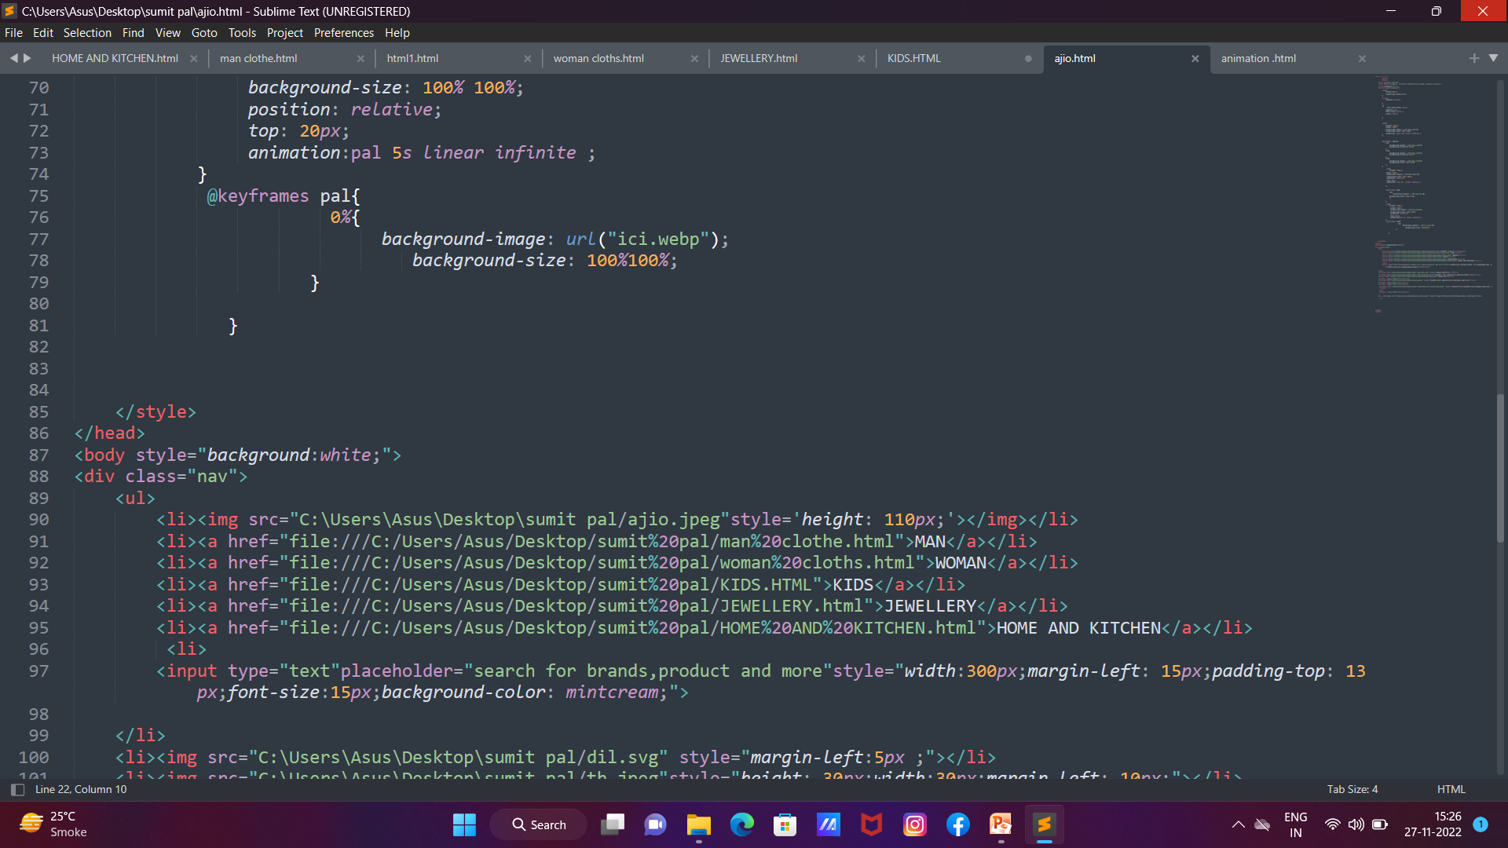

Slide 7
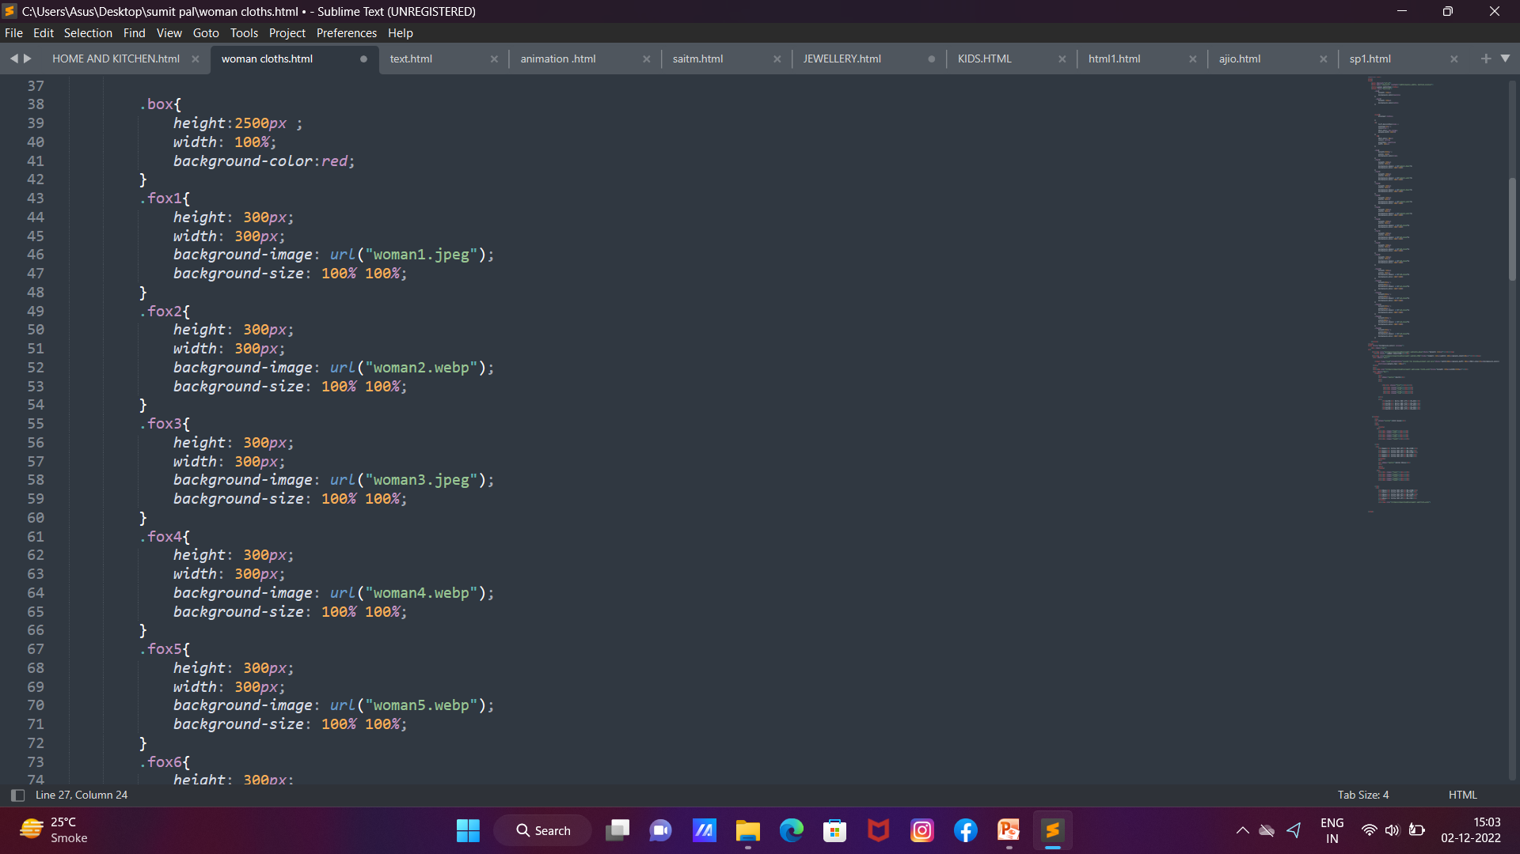

Slide 8
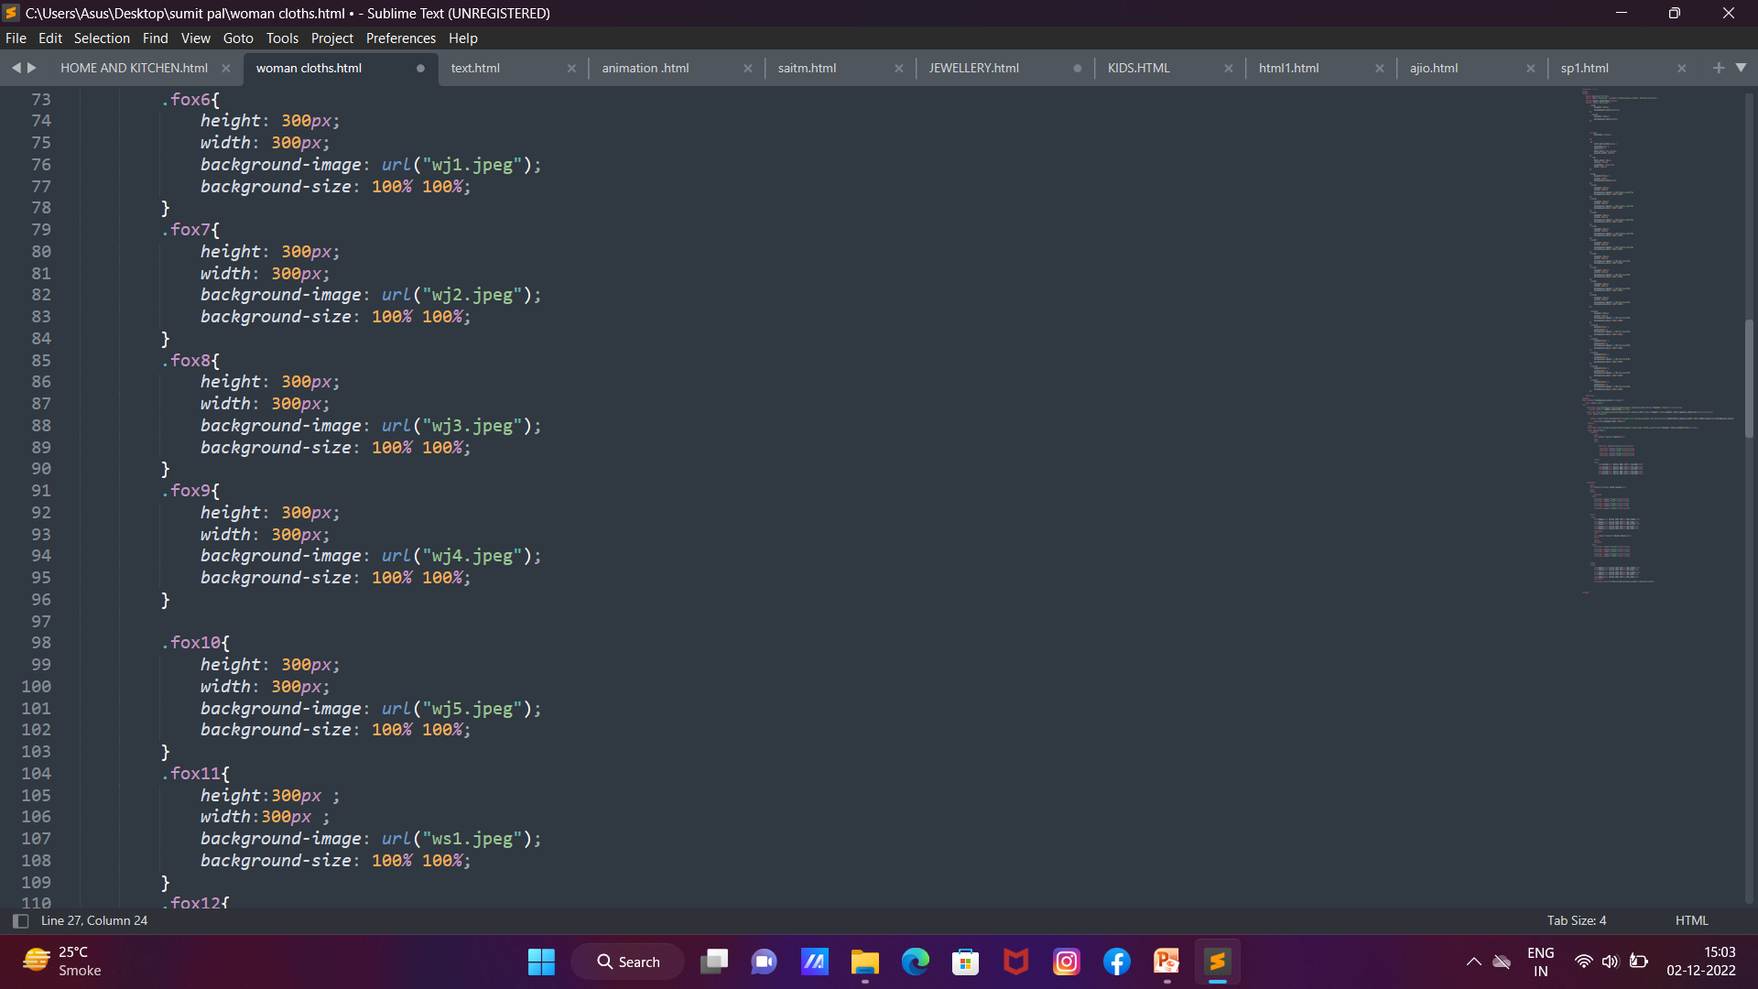

Slide 9
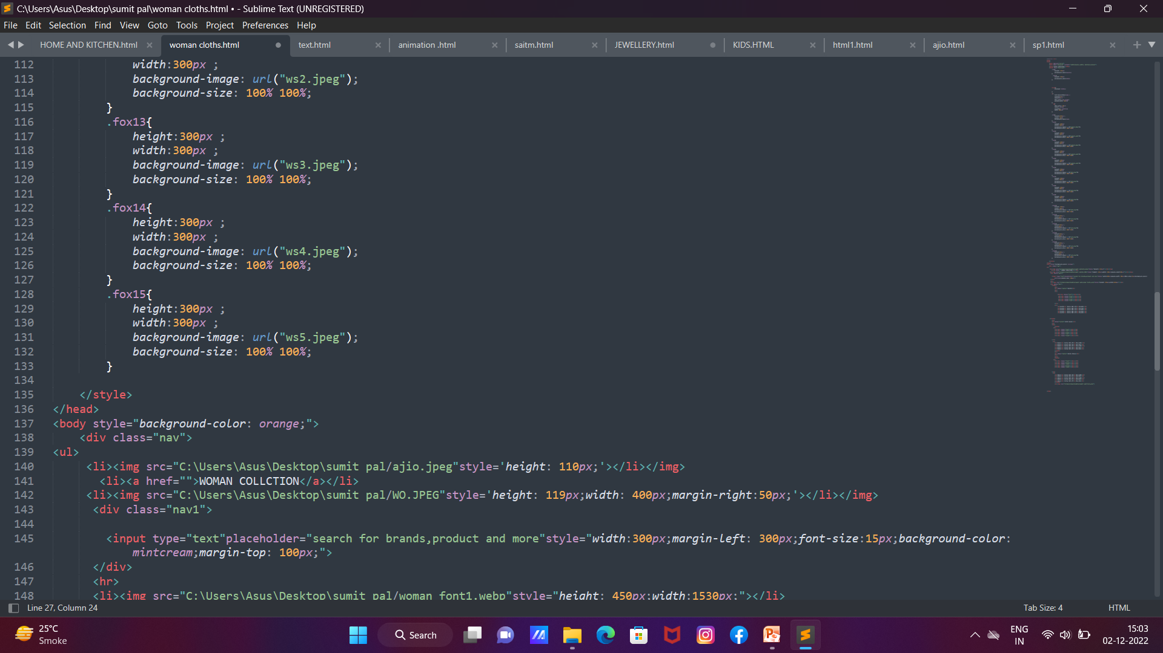

Slide 10
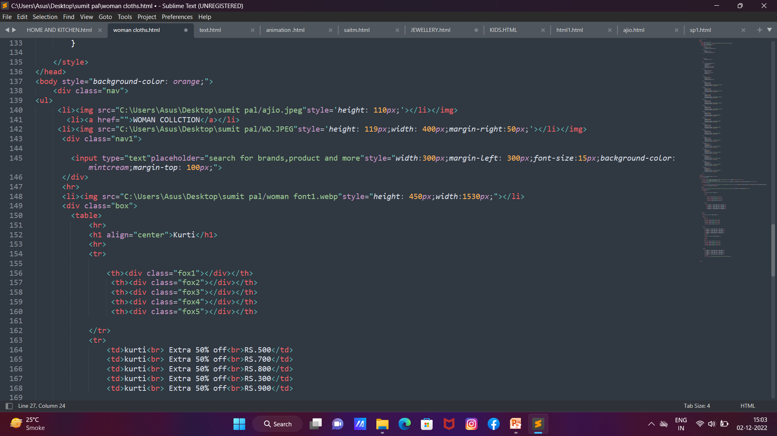

Slide 11
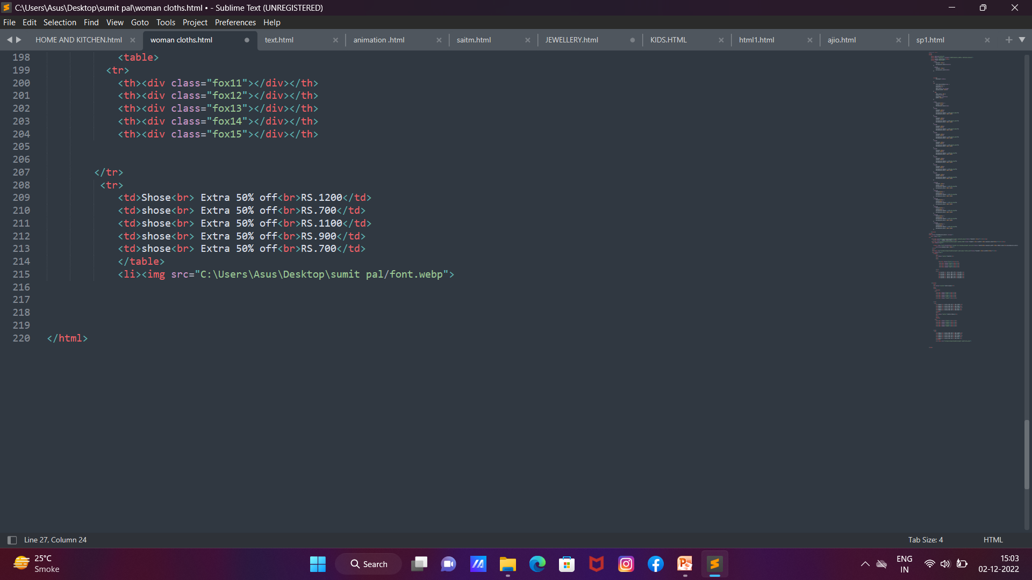

Slide 12
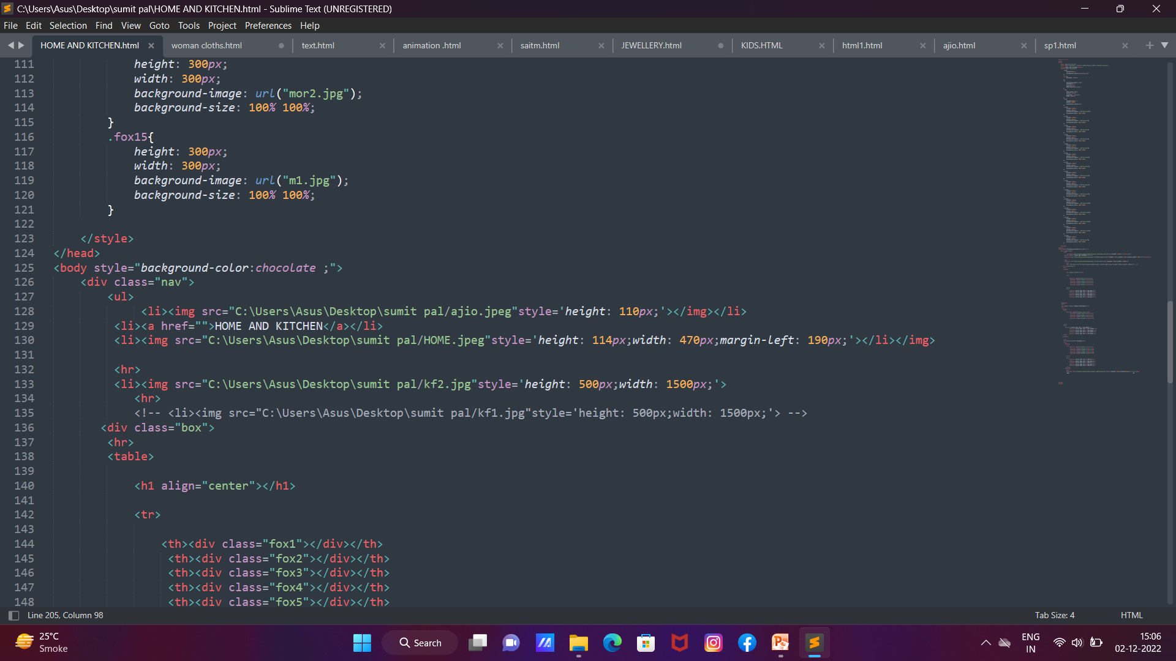
Source Code(CSS)

Slide 13
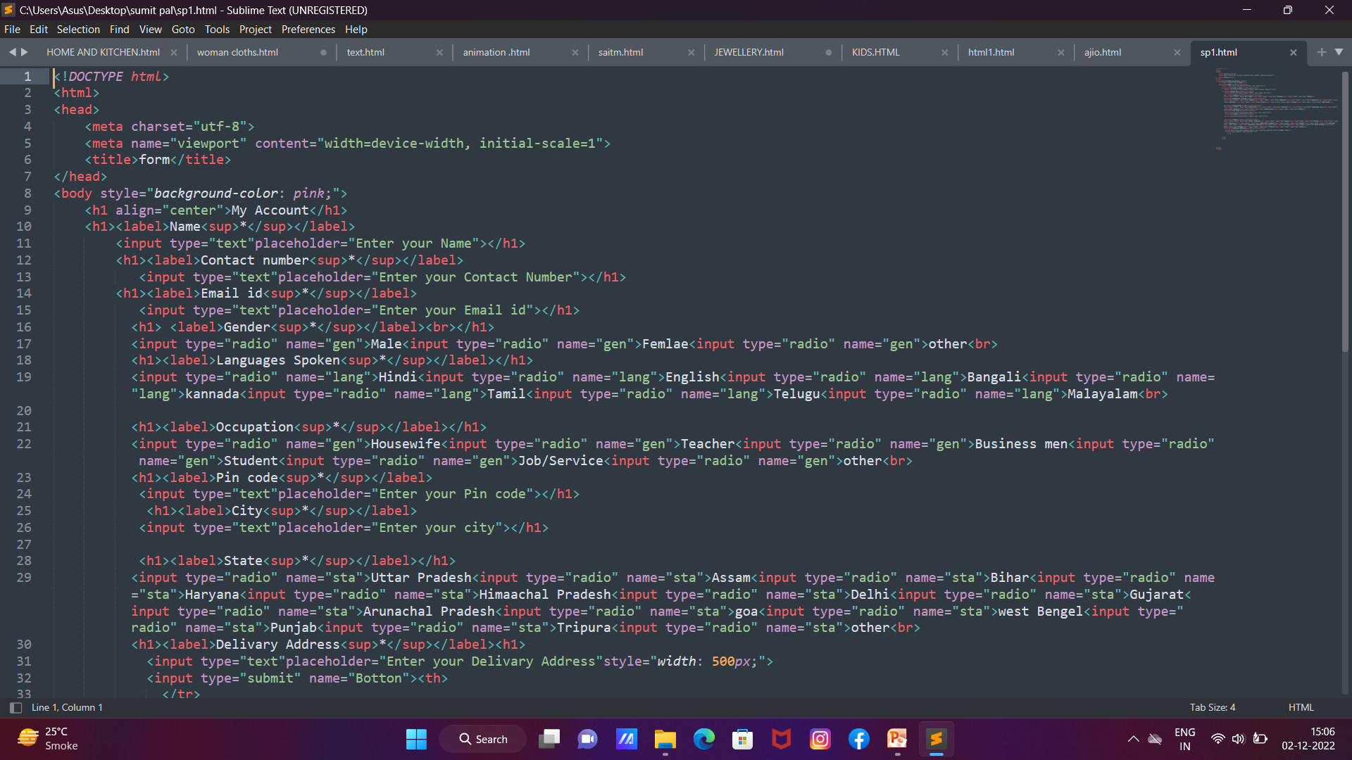

Slide 14
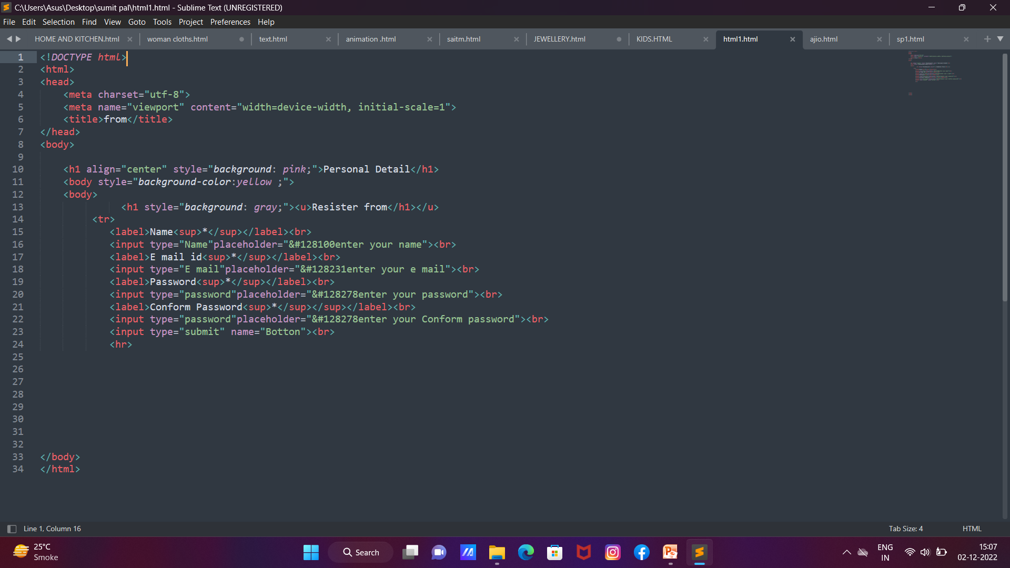

Slide 15
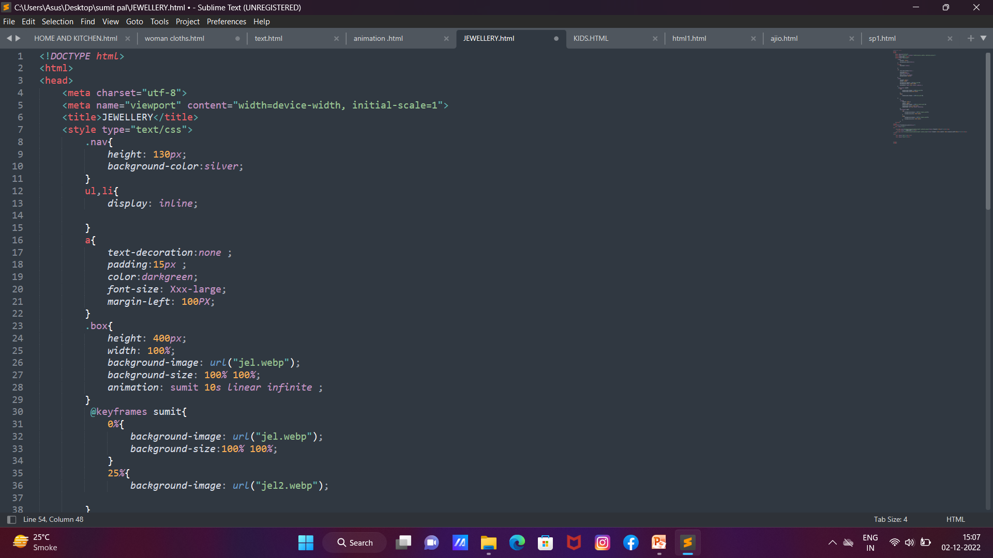

Slide 16
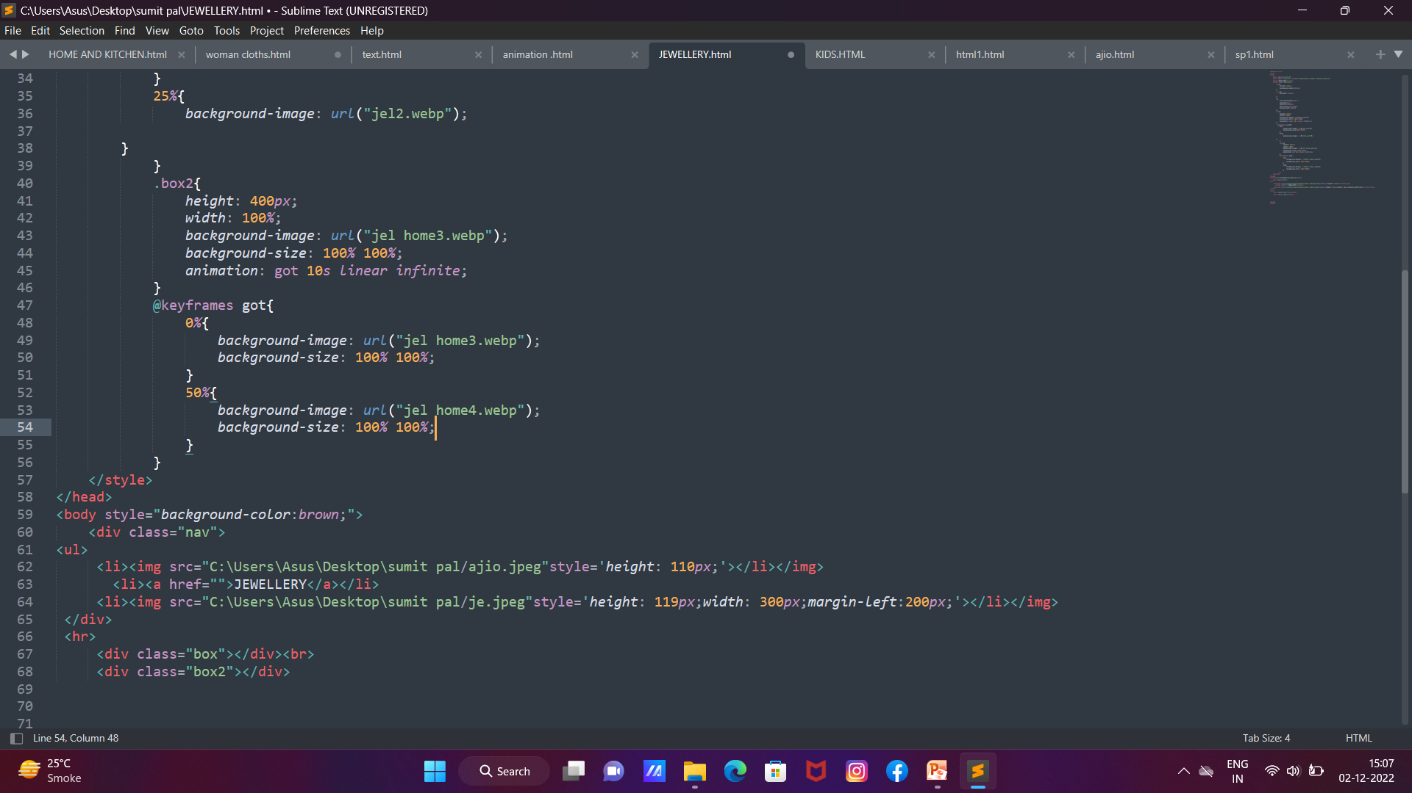

Slide 17
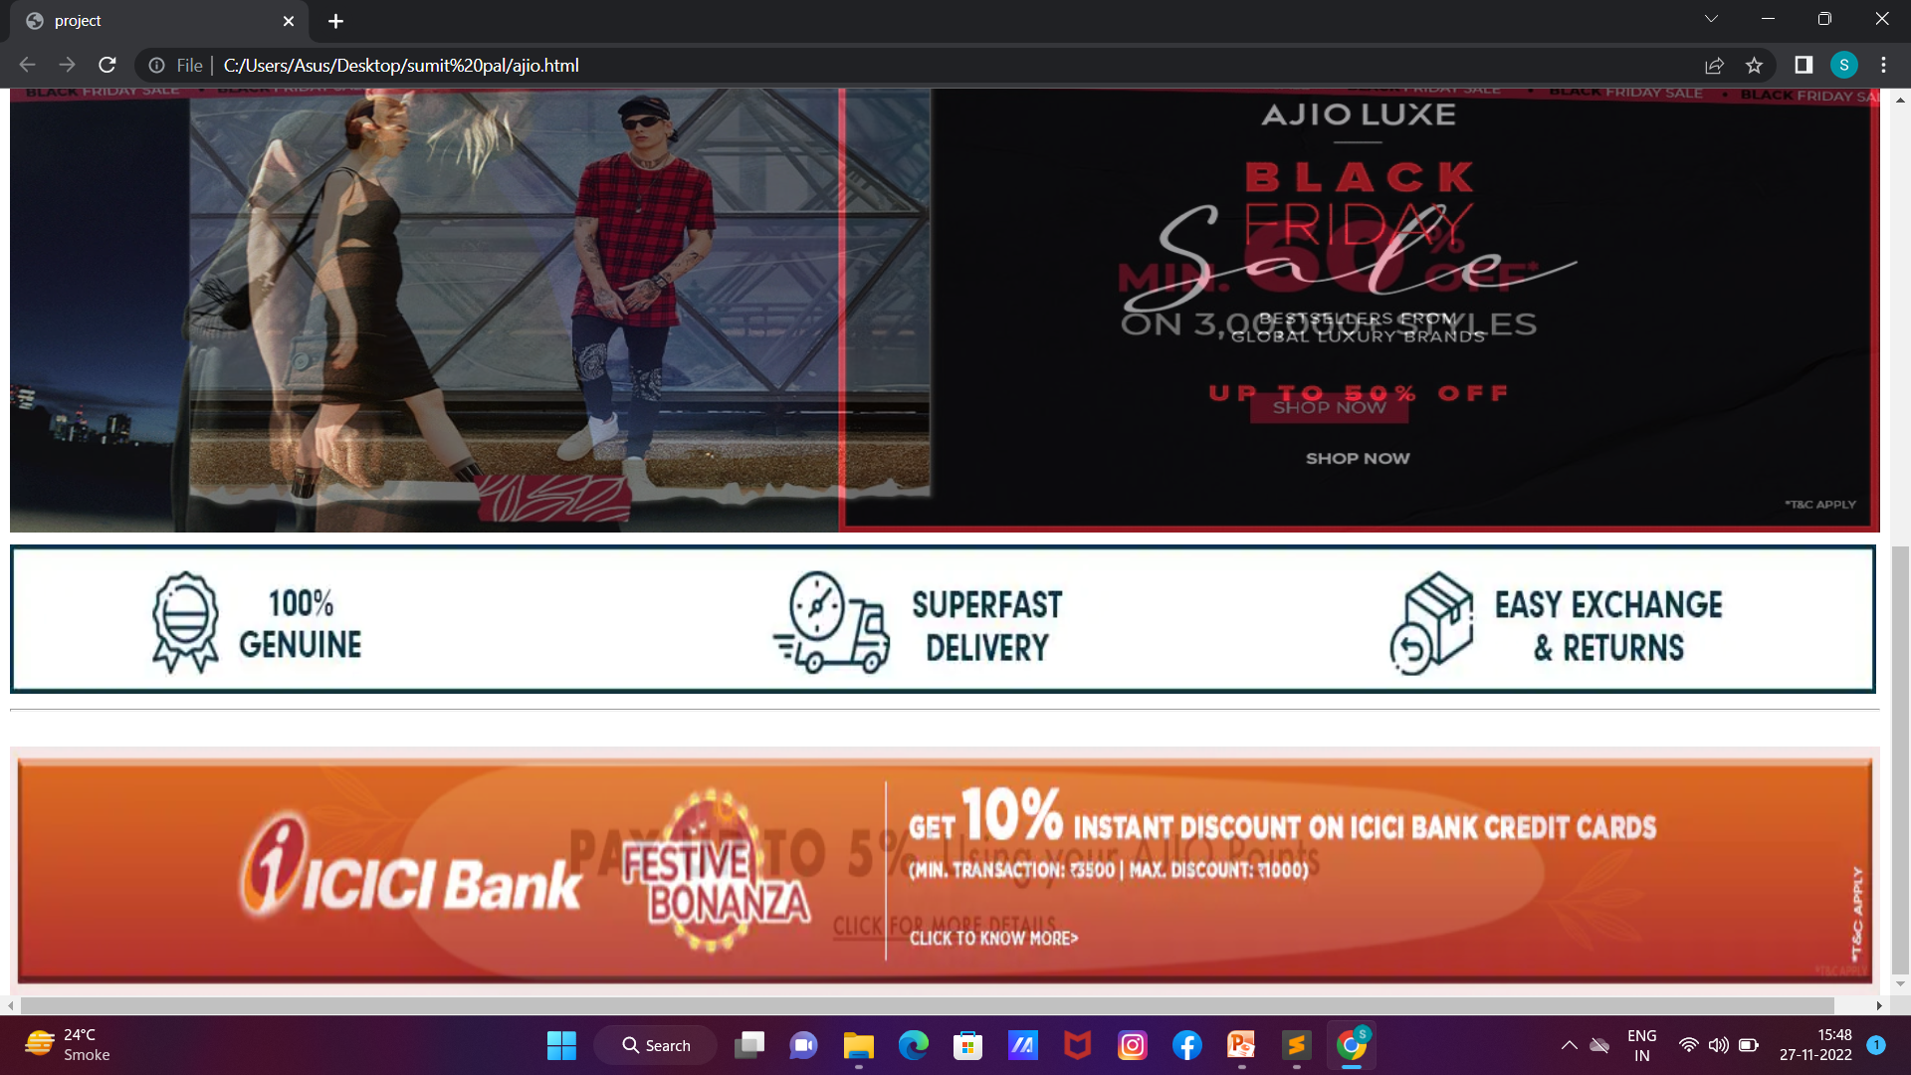

Slide 18
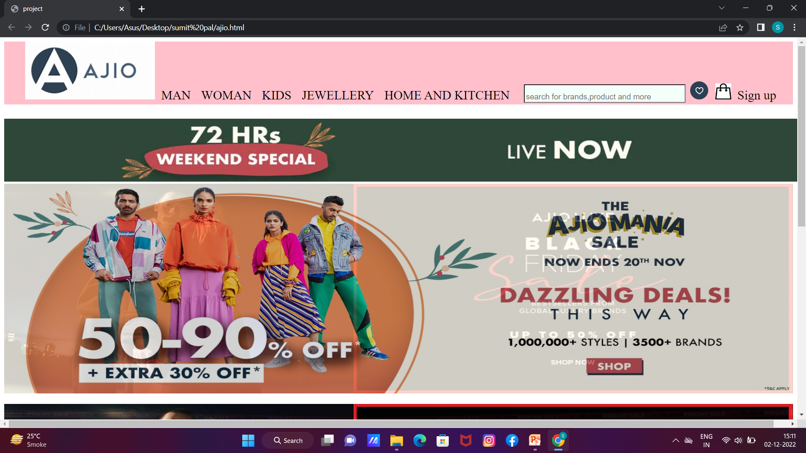
Output

Slide 19
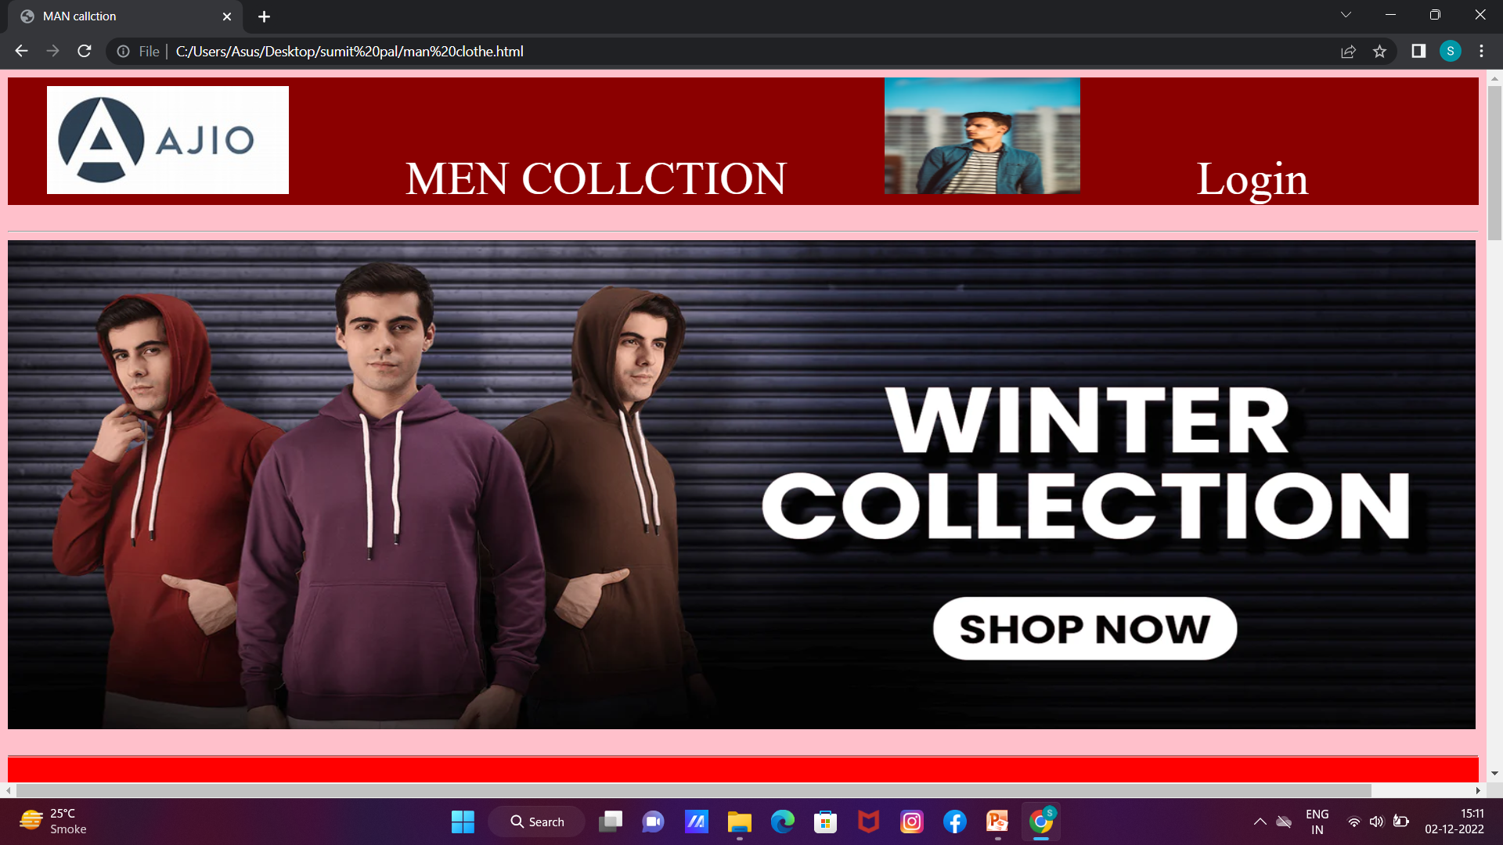

Slide 20
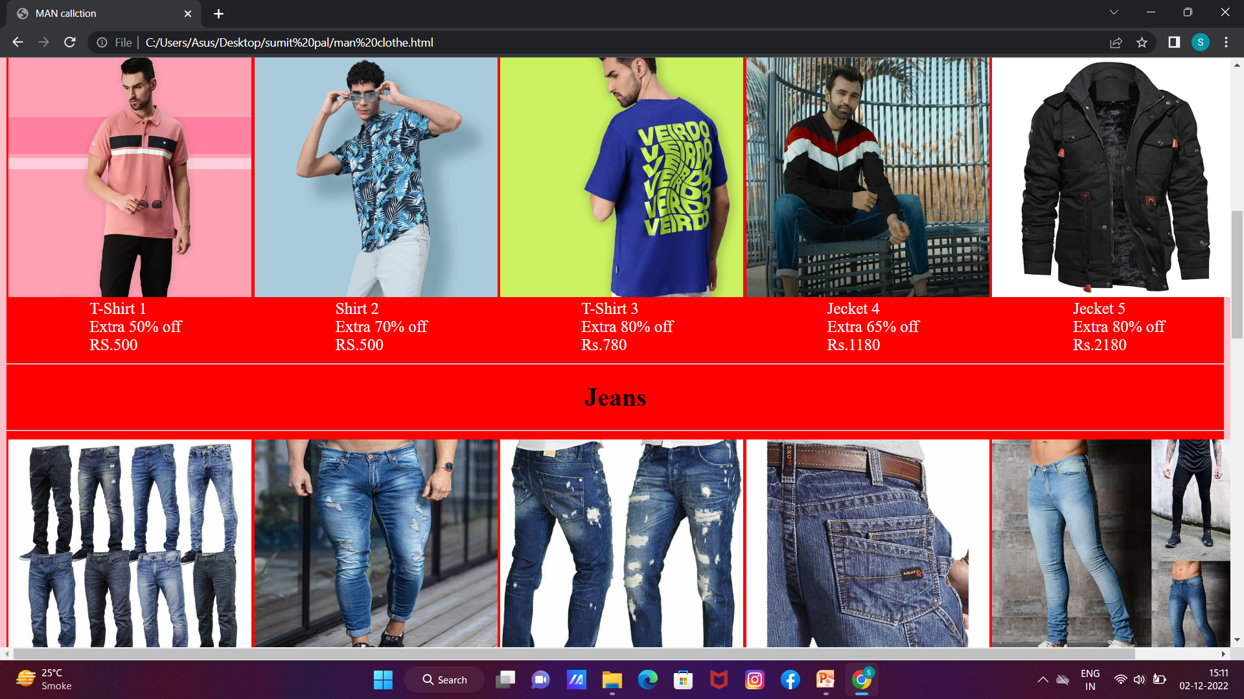

Slide 21
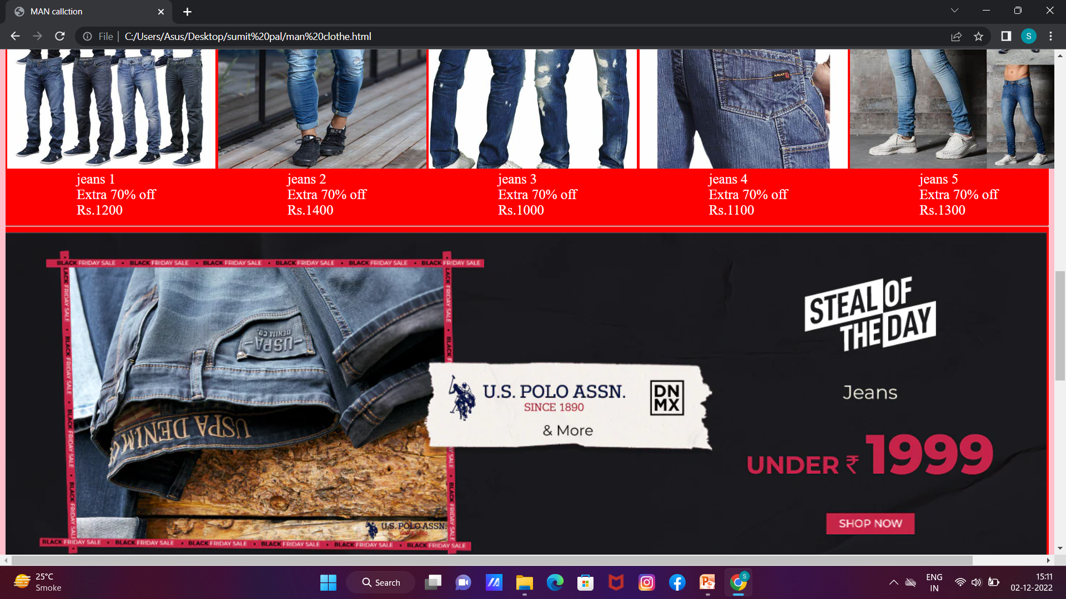

Slide 22
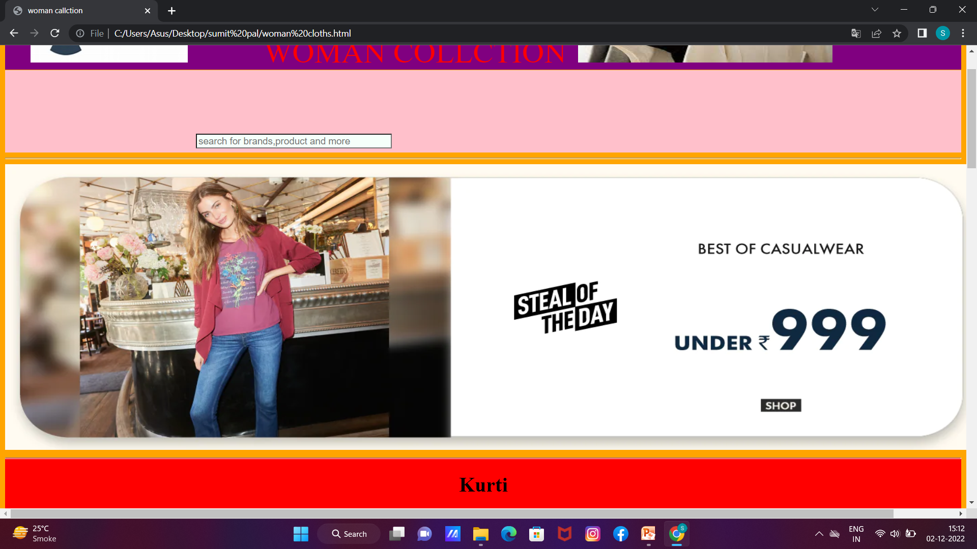

Slide 23
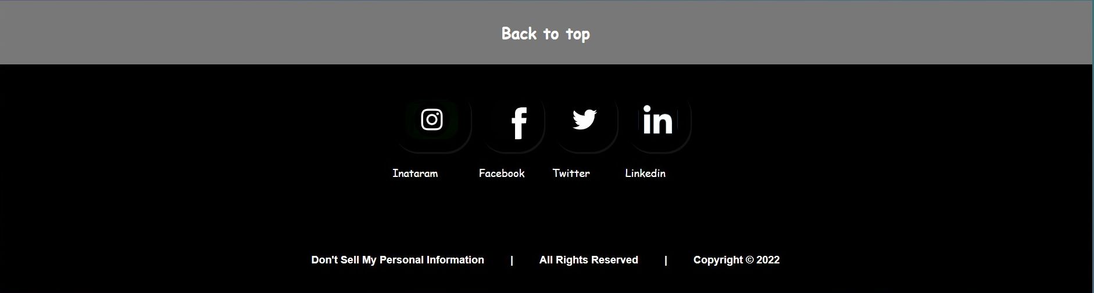

Slide 24
BIBLIOGRAPHY
Wikipedia
W3School
Google
Youtube

